Slide 1
Schneider Electric Hackathon.
Solution of the data challenge through Automated Machine Learning
Our algorithm repository can be found here: https://github.com/israelCamperoJurado/GAMA_generalized_island_model_AutoML.git
Authors:
Juan Antonio Bellido Jiménez
Israel Campero Jurado
Gregorio Aurelio Bueno Bueno

Slide 2
Data preprocessing
CSV
JSON
PDF
Download and extract PDF Files
Download and save files from URLs
Data extraction and treatment
Read using Pandas
Save to CSV file
'FacilityInspireID'
'facilityName'
'targetRelease'
'CITY ID'
'REPORTER NAME' 'EPRTRAnnexIMainActivityLabel',
'eprtrSectorName'
'CONTINENT'
Homogenize names in columns
Delete non-important features based on different analysis.

Slide 3

Data preprocessing
Data Modification due to categorical features
One hot encoding
Label Encoding
Split into train and test
70% Train
30% Test
Build final model

Slide 4
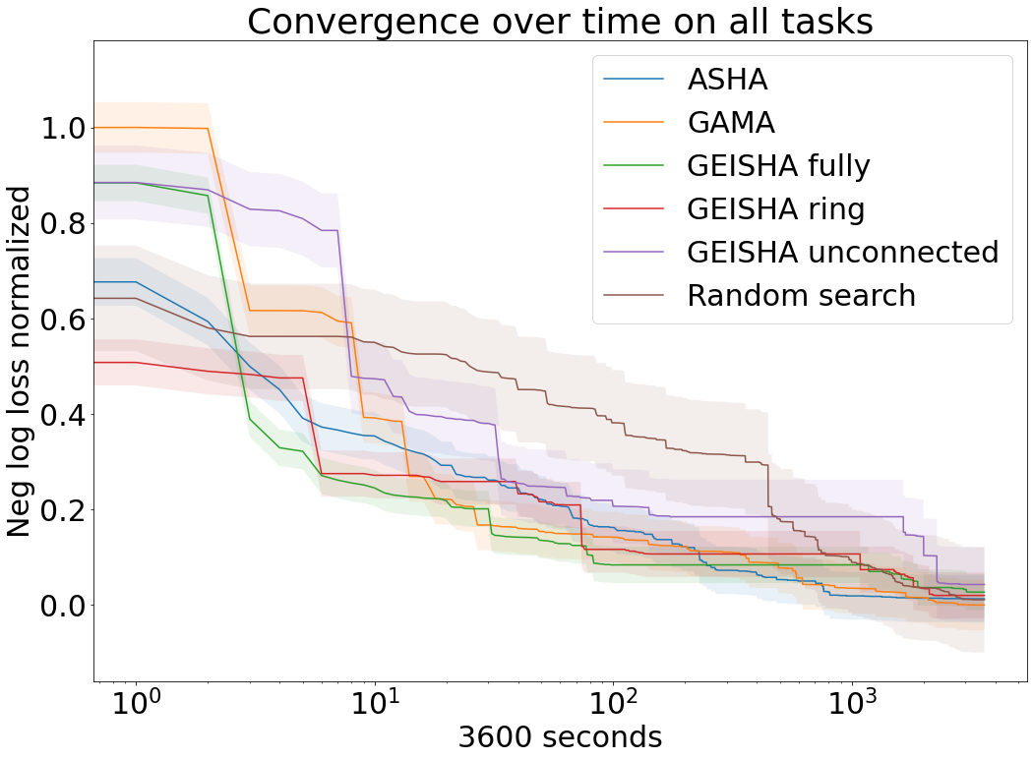
Automated Machine learning
We use an algorithm we developed for AutoML:
This algorithm combines 8 bio-inspired algorithms
We use a 5400 second search
The best pipeline obtained by genetic optimisation is:
Pipeline(steps=[('imputation', SimpleImputer(strategy='median')),
('0',
DecisionTreeClassifier(max_depth=5, min_samples_leaf=13,
min_samples_split=15))])

